Slide 1
map of BTS colours
album covers
v 1.0.0

Slide 2
main idea
what are the main colours in BTS album covers?

Slide 3

grandmother story
this was unfinished since at least April last year (I also start too many things and finish barely anything, lack of deadlines does not create urgency or priority)
also cos i was looking at how to scraped automatically save images from sites
the issue I had then was I was wondering if I can dynamically determine k, never solved this then my laptop died in Seoul so this whole thing was not just put aside I lost the code (git habits are important everyone)
The reason I am doing this

Slide 4
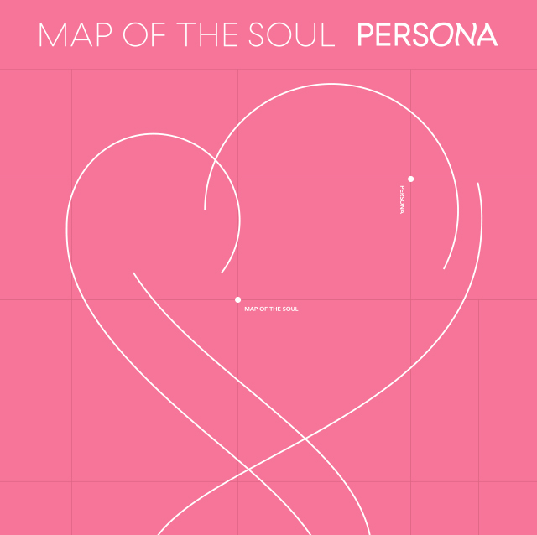
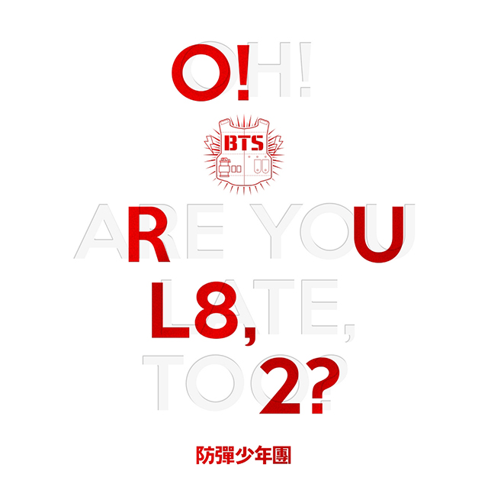
why dynamically determine k?
1
some covers clearly do not have more than 2 “big” colours
2
Lol why not, might be fun
(famous last words)

Slide 5
approach summary
find number of “top” colours in image
get the dominant colours
present it

Slide 6
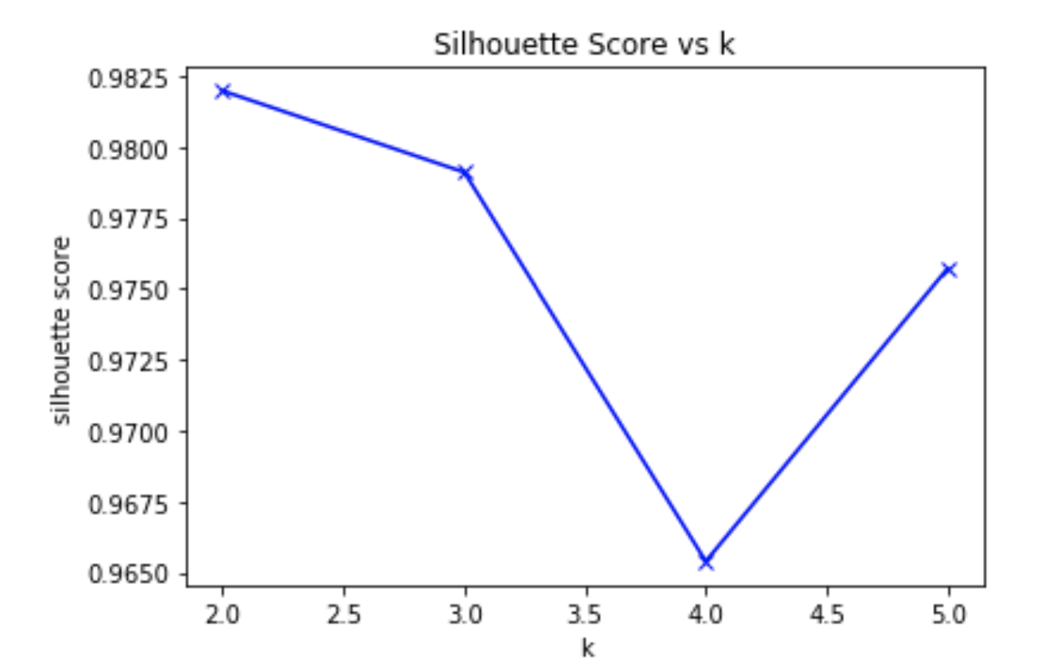
approach 1/3
silhouette score analysis
find number of “top” colours
(how many dominant colours are there in the image?)
k with top score is optimal k according to silhouette analysis

Slide 7
approach 2/3
Means that points clustered around is 1 dominant colour
k means
get dominant colours
(what are the k many dominant colours are there in the image?)
k (determined from 1/3) is how many centres to cluster around
K Means Data Clustering
https://towardsdatascience.com/k-means-data-clustering-bce3335d2203?gi=5e705cb5757f

Slide 8

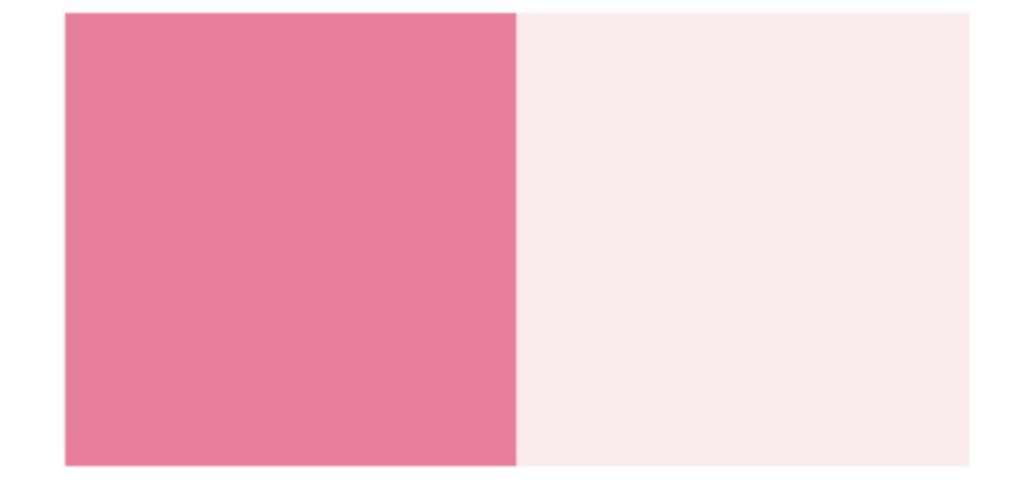
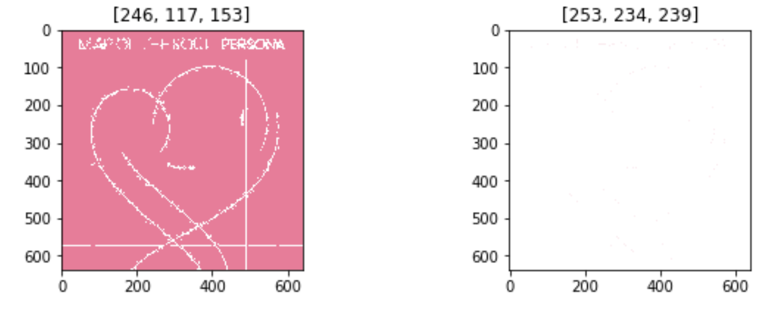
approach 3/3
(display with python)
colours relative to each other
just show them colours
colours in where they appear in the image

Slide 9
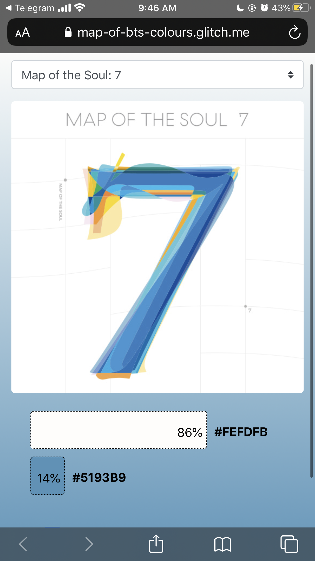
approach 3/3
(web display)
heard stuff about vue so decided to give that a go
web front was built with barely there vue, css and html
BUT IT WORKS
https://map-of-bts-colours.glitch.me

Slide 10
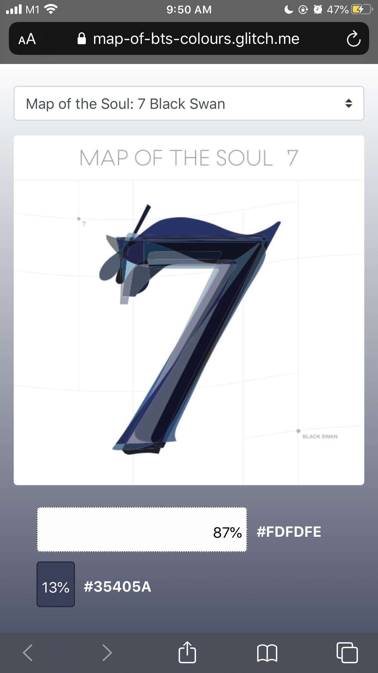
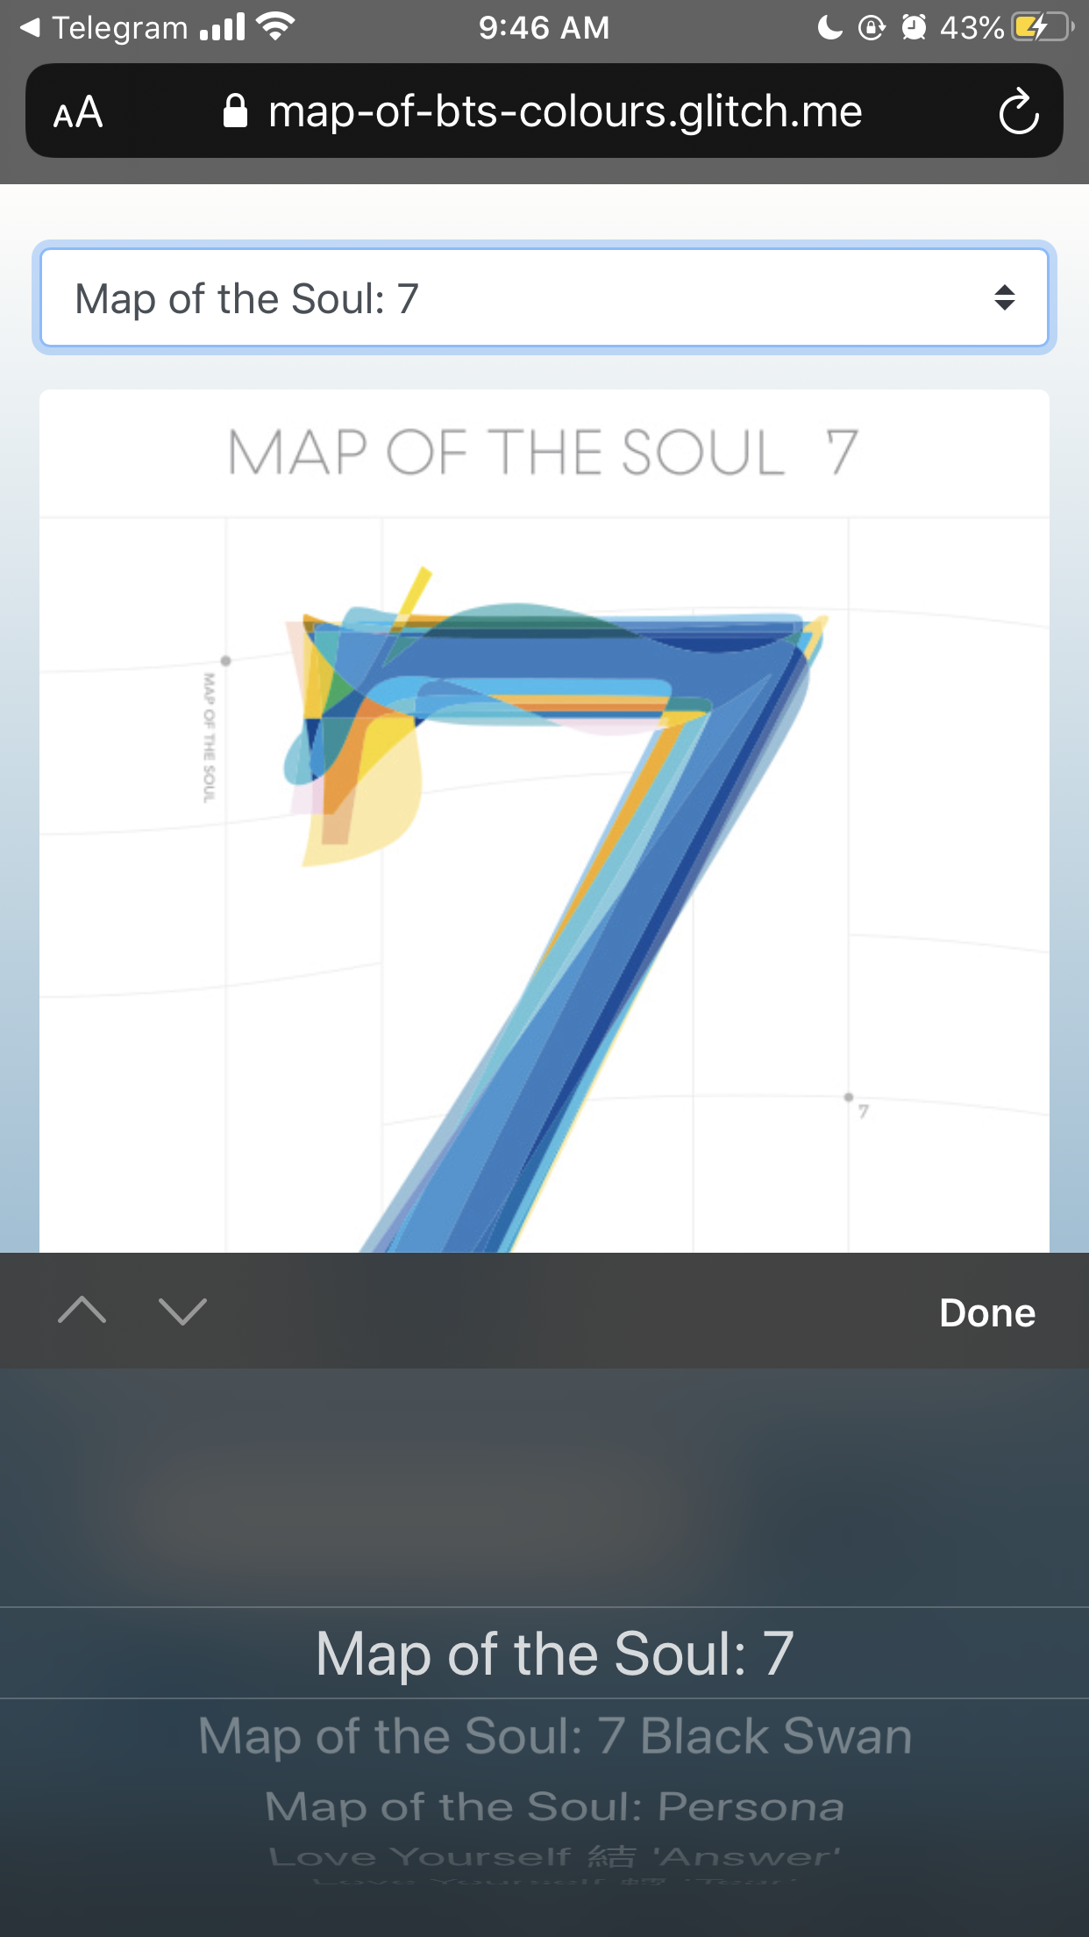
web display – main stuffs
different album
different colour profile
different background gradient

Slide 11
more stuffs for later maybe
extend to use for videos
extend to ”live” uses

